Slide 1

VIRTUAL APPLIED DATA SCIENCE TRAINING INSTITUTE
March 24, 2022
Module 3a: Introduction to Statistics in
Scientific Research
Paul Kolm, PhD Associate Director Center for Biostatistics, Informatics and Data Science MedStar Health Research Institute BERD-CTSA (Georgetown-Howard)

Slide 2
Outline
Statistics and estimation
Inferential statistics
Random sampling variability
Theoretical sampling distribution
Hypothesis testing and p values
Parametric statistics
Non-parametric statistics
Research design and analysis issues

Slide 3
Impact of Metabolic Syndrome and Diabetes on Prognosis and Outcomes With Early Percutaneous Coronary Intervention in the COURAGE (Clinical Outcomes Utilizing Revascularization and Aggressive Drug Evaluation) Trial. (Maron, et. al., JACC, 2011)
Statistical analysis. This was a post hoc analysis. Patient characteristics across groups were assessed by analysis of variance for continuous variables and the chi-square test for discrete variables. The Cochran-Armitage test was used for trend. Estimates of the cumulative event rate were calculated by the Kaplan-Meier method. Time-to-endpoint analyses were done using Cox regression or stepwise Cox regression. Cox regression was also used for the adjusted analyses. The rate of death or MI across subsets or treatment groups was assessed by the chi-square test.

Slide 4
The Risk of Cardiovascular Events in Primary Care Patients Following an Episode of Severe Hypertension. (Ewen, et. al., J. Clin. Hypertension, 2009)
Statistical Analysis
The chi-square statistic was used to compare proportions, the Kruskal-Wallis test was conducted to compare means and medians, and the Bonferroni correction procedure was used for all pair-wise comparisons. Poisson and negative binomial regression models were used to adjust observed incidence rates for age. The cumulative incidence of first and multiple cardiovascular events for each BP category was obtained by the Kaplan-Meier method, and differences among BP categories were evaluated using the log-rank test. Time-to-event was measured in years from the date of index until the date of cardiovascular event or censoring. Hazards ratios (HRs) were estimated from the Cox proportional hazards models and adjusted for age, sex, race, diabetes status and control, hyperlipidemia, and BP category at the index date. The proportional hazard assumption was assessed for each covariate and trend tests were performed by using the median value of each BP category as a continuous variable in a proportional hazards model.
A conditional multiple event technique was applied to account for multiple cardiovascular events and the Prentice–Williams–Peterson multiplicative hazards model was used to estimate HRs. Stata version 9 (Stata Corporation, College Station, TX), SAS version 9.1 (SAS Institute, Cary, NC), and SPSS version 15.0 (SPSS Inc, Chicago, IL) were used for statistical analyses.

Slide 5
What are statistics?
Summaries of individual measurements (e.g., mean)
Individual measurements implies…..?
Variability
Random variable: blood pressure, heart rate, gender, race, SAQ quality of life scores
Summaries of random variables

Slide 6
Estimating statistics
What does estimation imply?
Uncertainty
Think of statistics as the measurement (quantification) of uncertainty

Slide 7
Diastolic BP values of 144 patients
73 42 73 67 84 75 80 78 64 73 70 92
59 77 65 69 91 71 69 62 76 89 91 79
67 76 66 80 98 70 74 71 74 59 84 73
68 74 70 72 84 65 81 54 67 83 87 63
68 93 92 71 95 69 98 74 90 100 60 82
75 91 72 82 67 71 61 94 75 76 66 76
97 58 72 57 74 65 79 73 91 79 63 80
73 92 62 82 73 90 73 83 64 70 60 79
94 73 78 99 71 90 82 74 82 77 71 64
68 73 86 89 100 77 88 72 56 85 90 88
55 68 73 85 80 69 62 73 78 73 84 70
65 81 85 90 89 64 81 77 91 95 86 73

Slide 8
What is the dBP mean?
mean = Σ dBP_{i} / 144
144
i = 1
mean = 76.3

Slide 9
What is the dBP standard deviation?
144
Variance = Σ (mean – dBP_{i})² / (144 – 1)
SD = √variance
i = 1
Average variability about the mean.
Why divide by (144 – 1)?

Slide 10
Degrees of freedom (df) components of a statistic that are free to vary.
X1 + X2 + X3 = 100
50 + ?? + ?? = 100
50 + 40 + ?? = 100

Slide 11
Inferential statistical analysis
Comparison of two or more statistics.
Relationship (association, correlation) of random variables.
Prediction models of outcomes.
dependent variable ~ independent variable(s) + error

Slide 12
Measurement Scales
Continuous - infinite numerical scale where distances between scale divisions are equal - e.g., height
Ordinal - numerically ordered, but distances between scale divisions are not necessarily equal - e.g., cancer stages, grades
Counts – number of infections in ICU
Nominal (categorical) - values are labels - e.g., gender, race
Time-to-event – time continuous; event dichtomous

Slide 13
Research designs
Retrospective, case-control
Prospective, cohort (non-randomized)
Experimental - randomized

Slide 14
RESEARCH STUDIES DESIGNED TO ANSWER QUESTIONS ABOUT A POPULATION
Populations and samples
Population is the universe of all patients (e.g., all CAD patients undergoing PCI)
Sample is a segment of the universe typically drawn at random (more or less) from the population.
A potential bias in estimation / analysis from the sample is random sampling variability (chance).

Slide 15
Population
Research sample mean (x) ~ population mean (μ)
μ
x
Research sample
x
x
x
x
x
x
x
Over repeated sampling, the mean of the mean of the hypothetical samples equals the population mean
x
x
x
Hypothetical samples

Slide 16
Sampling distribution of diastolic BP
Sample(n = 5) Mean
63 73 61 73 66 67
90 92 56 68 60 73
69 67 85 72 73 73
90 80 55 73 77 75
69 74 91 73 66 75
64 71 80 76 94 77
62 91 79 89 62 77
81 76 91 77 63 78
95 91 73 65 72 79
72 82 73 90 81 80
83 75 69 92 79 80
89 90 77 80 82 84

Slide 17
The larger the sample, the more accurate the estimation of the population parameter.
Is the sample representative of the population?

Slide 18
Variability
Standard deviation: variability of data about its mean.
Standard error: variability of a statistic (e.g. means:
SEM = SD / √n).

Slide 19
95% confidence intervals for dBP from hypothetical samples (n = 5)
Population mean dBP = 76
Sample Mean SEM LB UB 5666666666677777777778888888888999999
9012345678901234567890123456789012345
72 82 73 90 81 80 3 70 89 (-----x------------)
89 90 77 80 82 84 3 77 91 x(-------------)
95 91 73 65 72 79 6 63 95 (------------x------------------)
83 75 69 92 79 80 4 69 90 (------x-------------)
64 71 80 76 94 77 5 63 91 (------------x--------------)
63 73 61 73 66 67 2 60 74 (-------------) x
69 67 85 72 73 73 3 64 82 (-----------x-----)
62 91 79 89 62 77 6 59 94 (----------------x-----------------)
81 76 91 77 63 78 5 65 90 (----------x-------------)
69 74 91 73 66 75 4 63 87 (------------x----------)
The sample means constitute a sampling distribution (distribution of statistics).
The standard error of the mean (SEM) quantifies variability of the sampling distribution.
95% CI is equal to the mean ± 2 x SEM (2 is standard deviation units of the normal distribution).
The mean of the sampling distribution will approximate the population mean.
The larger the sample size, the smaller the standard error.

Slide 20
Confidence interval
Over repeated sampling, a 95% CI will include the population mean 95 times out of every 100 random samples.

Slide 21
Theoretical sampling distributions
Use theoretical distribution to model empirical distribution
Use theoretical distribution to model distribution of sample statistics
Theoretical distribution has a mathematical formula
Easily calculate probabilities of random variables for given distribution

Slide 22
NORMAL DISTRIBUTION
A normal distribution is defined by two parameters, its mean and standard deviation. It is a symmetrical distribution in which the measures of central tendency, the mean, median and mode are equal.

Slide 23
34% 34%

Slide 24
95%
2.5%
2.5%

Slide 25
Other theoretical distributions
χ² - contingency table analysis & gof
t - compare means & correlations
F - analysis of variance (ANOVA)
The above distributions are sample size dependent and as sample size → ∞, tend to a normal distribution

Slide 26
Statistical significance and p values
All statistical analyses involve two sources of variance of the outcome variable in the data.
Known variance: treatment group, age, race, etc.
Unknown variance: error variance
Statistical tests:
T = known variance / unknown variance
p value is the probability of obtaining a value of T or larger, just by random sampling variability (chance)

Slide 27
Hypothesis Testing
Treatment: 80 88 76 77 84 Mean = 81
Control: 84 90 86 77 93 Mean = 86
Null hypothesis: There is no difference between the means of the Treatment and Control groups (i.e., chance)
Alternative hypothesis: There is a difference between means of the Treatment and Control groups (difference unlikely to have occurred just by chance)

Slide 28
STATISTICAL DECISIONS
ASSUME NULL HYPOTHESIS TRUE
Statistical tests give probability of obtaining the value of the test statistic, or larger (t, F, etc.) by chance and, by inference, whether differences “statistically significant”.

Slide 30
Treatment: 80 88 76 77 84 Mean = 81 + 5
Control: 84 90 86 77 93 Mean = 86 + 6
t = difference in means divided by the standard error of the difference
Which t distribution? (depends on sample size)
t distribution defined by degrees of freedom (df)
df = number of components of a statistic that are free to vary
X1 + X2 + X3 = 100
50 + X2 + X3 = 100
50 + 40 + X3 = 100

Slide 31
Use 5 values to compute a mean, to compute variance, only 4 values needed:
(80-81)²+(88-81)²+(76-81)²+(77-81)²+(84-81)²
5 - 1
first 4 values can be any number (free to vary); the mean is known, so once the first 4 numbers are known, there is only one possible value for the 5th number
So df = 5 -1 = 4

Slide 32
t-test for difference in two independent means
Difference in the two means divided by the standard error of the difference of two means
with df = n₁ – 1 + n₂ – 1

Slide 33
81 - 86
t = ------------------------------------------------
5² (5 – 1) + 6² (5 -1) _{x (1/5 + 1/5)}
5 -1 + 5 -1
= -1.4142
t(8) = -1.4142
p = 0.0975

Slide 34
p value
one-sided = 0.0975
two-sided = 0.0975 x 2 = 0.1950
Fail to reject the null hypothesis at the 0.05 level

Slide 35
Conclusions?
There is no difference between treatment and control, the treatment does not lower heart rate.
NO!
There is no evidence for a treatment effect.

Slide 36
Categorical outcome (2 categories)
Positive-negative; disease-no disease dead-alive
Treatment A: 84 of 184 patients had a positive outcome
Treatment B: 72 of 202 patients had a positive outcome
Proportion of positive outcomes different for A and B?

Slide 37
Proportion (A) = 84/184 = 0.457
standard error = √ (0.457)*(1-0.457)/184
= 0.037
Proportion (B) = 72/202 = 0.356
Standard error = √ (0.356)*(1-0.356)/202
= 0.034

Slide 38
Difference in independent proportions
z = difference in proportions divided by standard error of difference
Standard error = √ (p*(1-p)*(1/n₁ + 1/n₂) where p is overall proportion
Δ = 0.457(84/184) - 0.356 (72/202) = 0.1001
p = 156/386 = 0.4041
1 – p = 0.5959
1/184 + 1/202 = 0.0104
z = 0.1001/ √ 0.4041*0.5959*0.0104
= 2.0014, p = 0.0454 (two-sided)
Reject null hypothesis that 84/184 - 72/202 is due to sampling variability
Conclusion: Treatment A resulted in a statistically significantly greater proportion of positive outcomes than treatment B (0.457 vs. 0.356).

Slide 39
Chi-square
Create row by column (r x c) table of treatment groups and outcomes
Calculate squared difference between observed and expected frequencies, divide by expected cell frequency; sum over all cells
Expected = (row total * column total)/grand total
Distributed as chi-square with df = (r-1) * (c-1)

Slide 40
+ -
A
B
84
100
184
72
130
202
156
230
386

Slide 41
+ -
A 84 100 184
B 72 130 202
156 230 386
E1 = 184*156/386; E2 = 184*230/386; E3 = 202*156/386; E4 = 202*230/386
χ² = (84-74.4)² + (100-109.6)² + (72-81.6)² + (130-120.4)²
74.4 109.6 81.6 120.4
= χ² (1) = 4.005, p = 0.0454

Slide 42
If study is prospective, calculate relative risk (RR) from 2 x 2 table:
Disease No Disease
Risk factor present 84 100 184
Risk factor absent 72 130 202
RR = (84/184) / (72/202)
= 1.281

Slide 43
If study is retrospective, calculate odds ratio (OR) from 2 x 2 table:
Disease No Disease
Risk factor present 84 100
Risk factor absent 72 130
156 230
Odds that patients with disease had risk factor = (84/156) / (72/156)
Odds that patients w/o disease had risk factor = (100/230) / (130/230)
OR = [(84/156) / (72/156)] / [(100/230) / (130/230)]
= (84*130) / (72*100)
= 1.517

Slide 44
RR and OR
Prospective study estimates true incidence rate
Retrospective study does not – samples from population of disease/no disease
When incidence rate is small, RR and OR equal

Slide 45
What a p value is NOT
The probability that the alternative hypothesis is “true”.
Probability that the null hypothesis is “false”.
Indication of importance, meaningfulness, relevance, etc. statistical significance vs. clinical significance.
No such thing as “Highly significant” (p = 0.0001). It is or it isn’t.
No such thing as a “trend towards significance” (p = 0.06).

Slide 46
What a p value is
Probability of obtaining a test statistic as large or larger than that calculated assuming the null hypothesis is true.
Underlying assumption of repeated sampling.
Dependent on sample size.
Arbitrary

Slide 47
Basic concepts Break 10 minutes

Slide 48
Statistical Methods
Parametric – assume some theoretical distribution for data / test statistic
Non-parametric – no assumptions about distribution

Slide 49
Correlation
Virtually all medical research is concerned with correlating variables – in some form or another.
At the simplest level, correlation is an assessment of the linear rank ordering of two variables – how the values of one change in relationship to the other.
Quantified by the correlation coefficient:
Perfect inverse relationship (-1)
No relationship (0)
Perfect positive relationship (+1)

Slide 50
PT Cholesterol Weight Age
(mg/100 ml) (kg) (years)
1 354 84 46
2 190 73 20
3 405 65 52
4 263 70 30
5 451 76 57
6 302 69 25
7 288 63 28
8 385 72 36
9 402 79 57
10 365 75 44
11 209 27 24
12 290 89 31
13 346 65 52
14 254 57 23
15 395 59 60
16 434 69 48
17 220 60 34
18 374 79 51
19 308 75 50
20 220 82 34
21 311 59 46
22 181 67 23
23 274 85 37
24 303 55 40
25 244 63 30
rchol|age = 0.84

Slide 51
Σ (y_{i} – Y)² = Σ ((y’ – Y)² + (y_{i} – y’)²)
y_{i}
SS_{T} = SS_{regression} + SS_{error}
SS_{error}
R² = SS_{regression} / (SS_{regression} + SS_{error})
SS_{Total}
Cholesterol
√ R² = abs(r)
y’
180 260 320 380 440
SS_{regression}
Y
30 40 50 60
Age

Slide 52
450
400
350
Cholesterol (ng/100ml)
300
250
200
20
30
40
50
60
Age (years)
Fitted values
chol = 102.6 + 5.3 * age

Slide 53
500
400
Cholesterol (ng/100ml)
300
200
20
30
40
50
60
Age
95% CI
Fitted values

Slide 54
General Linear Model (GLM)
dependent variable ~ independent variable(s)
Y = b₀ + b₁X₁ + b₂X₂ + b₃X₃ + . . . where Y is a continuous outcome (dependent variable)
X’s are the covariates (independents)
b’s are the estimated regression coefficients.
b is the change in Y for every unit increase (decrease if b is negative) in X adjusted for all other X’s in the model.
X’s can be a mix of continuous, ordinal or categorical variables.
The “statistical test” is whether the regression coefficients are different from zero.

Slide 55
GLM special cases
Y = b₀ + b₁X₁ is a t-test if X is dichotomous (1/0).
Y = b₀ + b₁X₁ + b₂X₂ + b₃X₃ is analysis of variance (ANOVA) if X’s are categorical.
If some X’s continuous – analysis of covariance (ANCOVA)

Slide 56
Generalized Linear Model
Dichotomous outcome: success-failure; dead-alive; positive-negative
Logistic regression (logistic distribution – S curve)
Model the probability of one of the dichotomies:
P = EXP(Y) / (1 + EXP(Y)) where
Y = b₀ + b₁X₁ + b₂X₂ + b₃X₃ + . . .
exp(b_{i}) = odds ratio (OR) adjusted for all other X’s in the model if design is retrospective.
Risk ratio (RR) if design is prospective.
Test is whether the odds ratios are different from 1.
The 95% CI will include 1 if the odds of the event are statistically the same for values or categories of a given covariate.

Slide 57
Special case of logistic regression
Y = b₀ + b₁X₁
If X is also dichotomous, 2 x 2 contingency table.
Outcome
+ -
Treatment A a b
Treatment B c d
OR = ad/bc

Slide 58
Generalized Linear Model (continued)
Ordered logistic regression: Y is ordinal
cancer stage: I, II, III, IV
Multinomial logistic regression: Y is nominal
Delivery: vaginal, vaginal-assisted, cesarean
Poisson regression: Y is a count within/over some time period.
Number of ICU infections from 1/1/2021 – 3/31/2021
Exponentiated regression coefficients are incident rate ratios (IRR).

Slide 59
Time-to-event models
Event: dichotomous (death, failure, recurrence)
Time to event: from a point of origin to a terminal event (e.g., date of diagnosis of disease to date of death from disease).
The terminal event occurs after the starting event.
Censoring - exact survival times not known (e.g., lost to follow-up).
Survival function, S(t) - the probability that a patient survives from the time of origin to some point beyond t.
Hazard rate - the probability that a patient dies at time t conditional on having survived to time t (i.e., the instantaneous death rate for a patient that survived to time t.
Hazard function: -H(t) = -log(S(t))
Survival function: S(t) = exp(-H(t))
Median survival time - time at which the survival rate is 50%.

Slide 60
Kaplan-Meier survival functions
Survival Proportion Cumulative
Time(mos) Patients Deaths Censored surviving Survival
0 74 0 0 1.0000 1.0000
7 74 1 0 .9865 .9865
11 73 1 0 .9863 .9730
12 72 1 0 .9861 .9595
18 71 3 0 .9577 .9190
20 68 5 0 .9265 .8514
25 63 0 2 1.0000 .8514
28 61 4 1 .9344 .7956
36 56

Slide 61
Kaplan-Meier survival curve with 95% CI

Slide 62
Multivariable survival models
Cox Proportional Hazards Regression
Model - given a pattern of covariate values z, the survival function is:
S(t,z) = [S0(t)]exp(βz)
where S0(t) is the baseline survival function corresponding to z = 0, i.e., no effect of covariates.
β is a vector of regression coefficients, one for each covariate.
(Y = b₀ + b₁X₁ + b₂X₂ + b₃X₃ + . . . )
In the following example, survival of colo-rectal cancer patients is modeled as a function of tumor GSH level to normal GSH level.
Model: S(t) = [S0(t)]exp(β1(GSH))

Slide 63
Cox regression of GSH on survival for colo-rectal cancer patients

Slide 64
Nonparametric statistics
Distribution-free
No assumption is made about the distribution of the outcome variable.
Mann-Whitney U test (t-test)
Wilcoxon matched-pairs signed-ranks test
Kruskal-Wallis (one-way analysis of variance)
Spearman / Kendall correlation
McNemar test for correlated proportions

Slide 65
Nonparametric statistics (continued)
Bootstrap – randomly select an observation from sample data with replacement.
Jackknife – leave-out-one

Slide 66
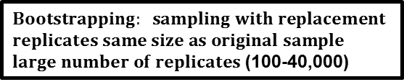
sample
Statistic (e.g., mean) of each replicate form a sampling distribution.
Calculate confidence intervals, test hypothesis
Bootstrap replicates

Slide 67
leave-out-one for 10 observations
X x₁ x₂ x₃ x₄ x₅ x₆ x₇ x₈ x₉ x₁₀
From the distribution of the x_{i}’s, bounds of a 95% CI can be found at the lower 2.5% and the upper 2.5% of the distribution regardless of whether the distribution is symmetrical.

Slide 68
Considerations for statistical analysis
Effect size
Paired vs. unpaired data
Clustered data
Selection bias in non-randomized comparative effectiveness studies
Consulting a statistician

Slide 69
Effect size
How much of a difference between interventions, groups, etc. in the outcome variable is “clinically meaningful”?
Difference in means, survival rates, proportions (size of an odds ratio if logistic regression) to detect
Variability of the outcome: standard deviation

Slide 70
Data for estimating effect size
Pilot studies
Published studies
Best case / worst case scenarios

Slide 71
Paired vs. unpaired data
Unpaired – data from independent entities (e.g., patients in treatment groups).
Paired – data from same patient or matched patients (e.g., repeated measures).
Paired analysis requires fewer patients and has more statistical power.
Within-patient variability.
If independent groups included in design – between-group variability and within-patient variability.

Slide 72
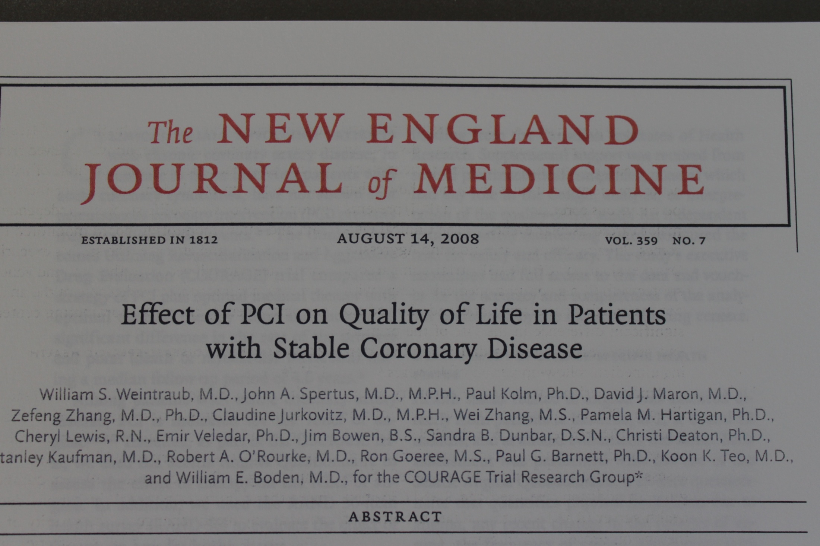

Slide 73
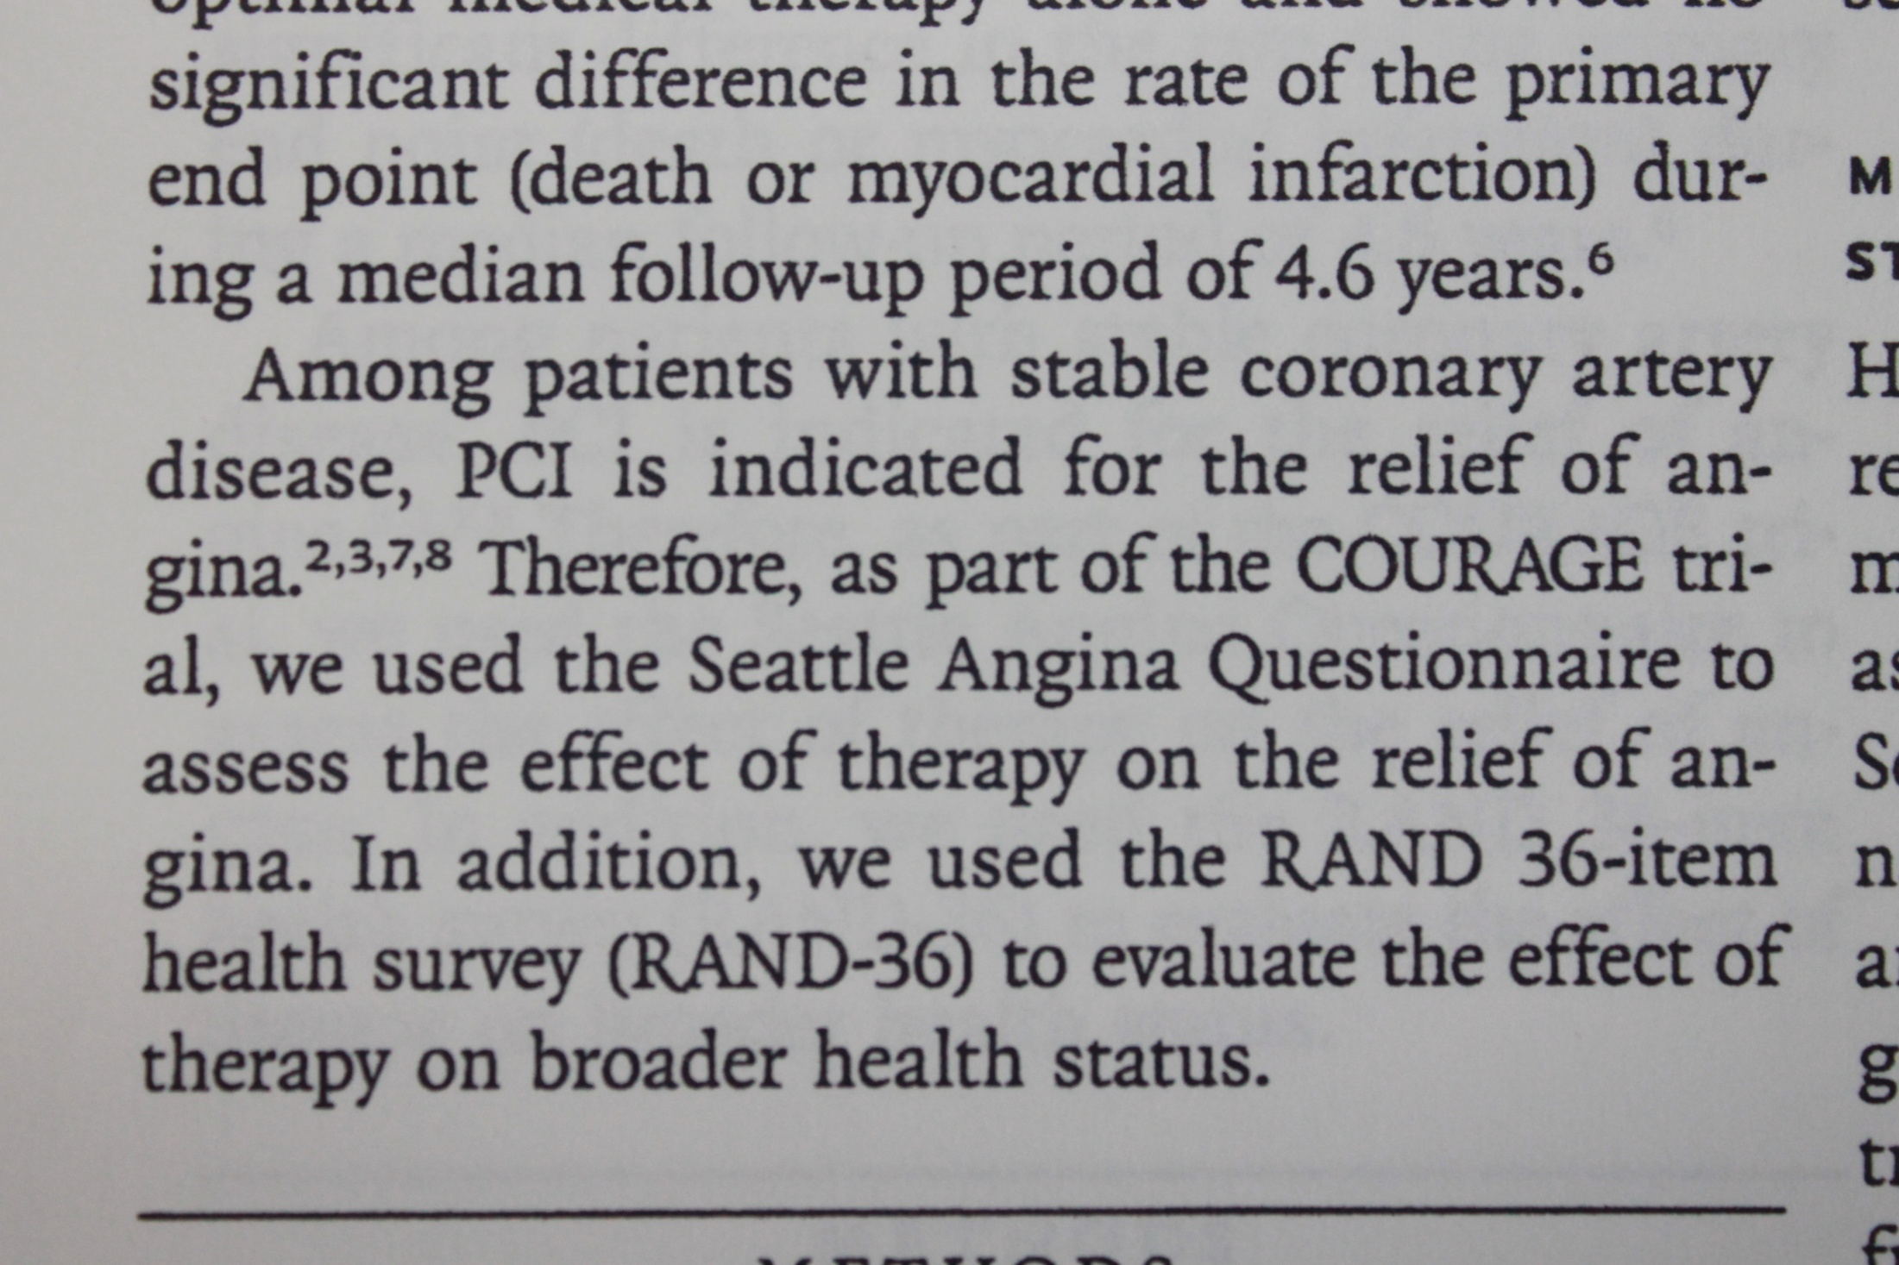

Slide 74
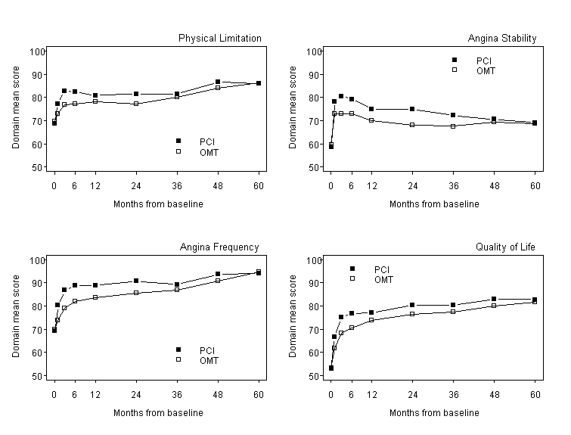

Slide 75
Clustered or Multilevel
Hierarchical
Clustered
Levels considered random effects
Variance component – variance of a random effect

Slide 76
Fixed effects – effects attributable to a finite set of levels of a factor (variable) that are of specific interest, e.g., treatment, sex, race, age.
Random effects – effects attributable to an infinite (or at least large) set of levels of a factor of which only a random (more or less) sample appear in the data, e.g., clinical trial sites, geographic regions, patients/subjects are always a random effect.

Slide 77
COURAGE TRIAL
US non-VA
Canada
VA
Site 1
Site 2
Site 3
Site 4
Site 5
Site 6
P1
P2
P3
P4
P5
P6
P7
P8
P9
P10
P11
P12
PCI OMT PCI OMT PCI OMT PCI OMT PCI OMT PCI OMT

Slide 78
Random effects issues
Data from a given cluster may be correlated, i.e., not independent.
Correlation may affect model parameters and standard errors if not accounted for.
Estimates / conclusions may be misleading.

Slide 79
Comparative Effectiveness Analysis in Non-randomized Studies
Pros _more data _data may already exist (EMR) _less expensive _realistic clinical practice environment
Cons _potential for selection bias and confounding

Slide 80
Solutions to reducing selection bias
Case-control matching (age, race, sex, etc.)
Covariate adjustment
Stratification
Propensity score analysis
Inverse probability weighting (IPW)
Instrumental variables

Slide 81
Coding Examples Break 10 minutes

Slide 82
Coding Workshop For up to an hour

Slide 83
Thank you!!
paul.kolm@medstar.net

